Slide 1
Presentation to:
Name & Date:

Slide 2
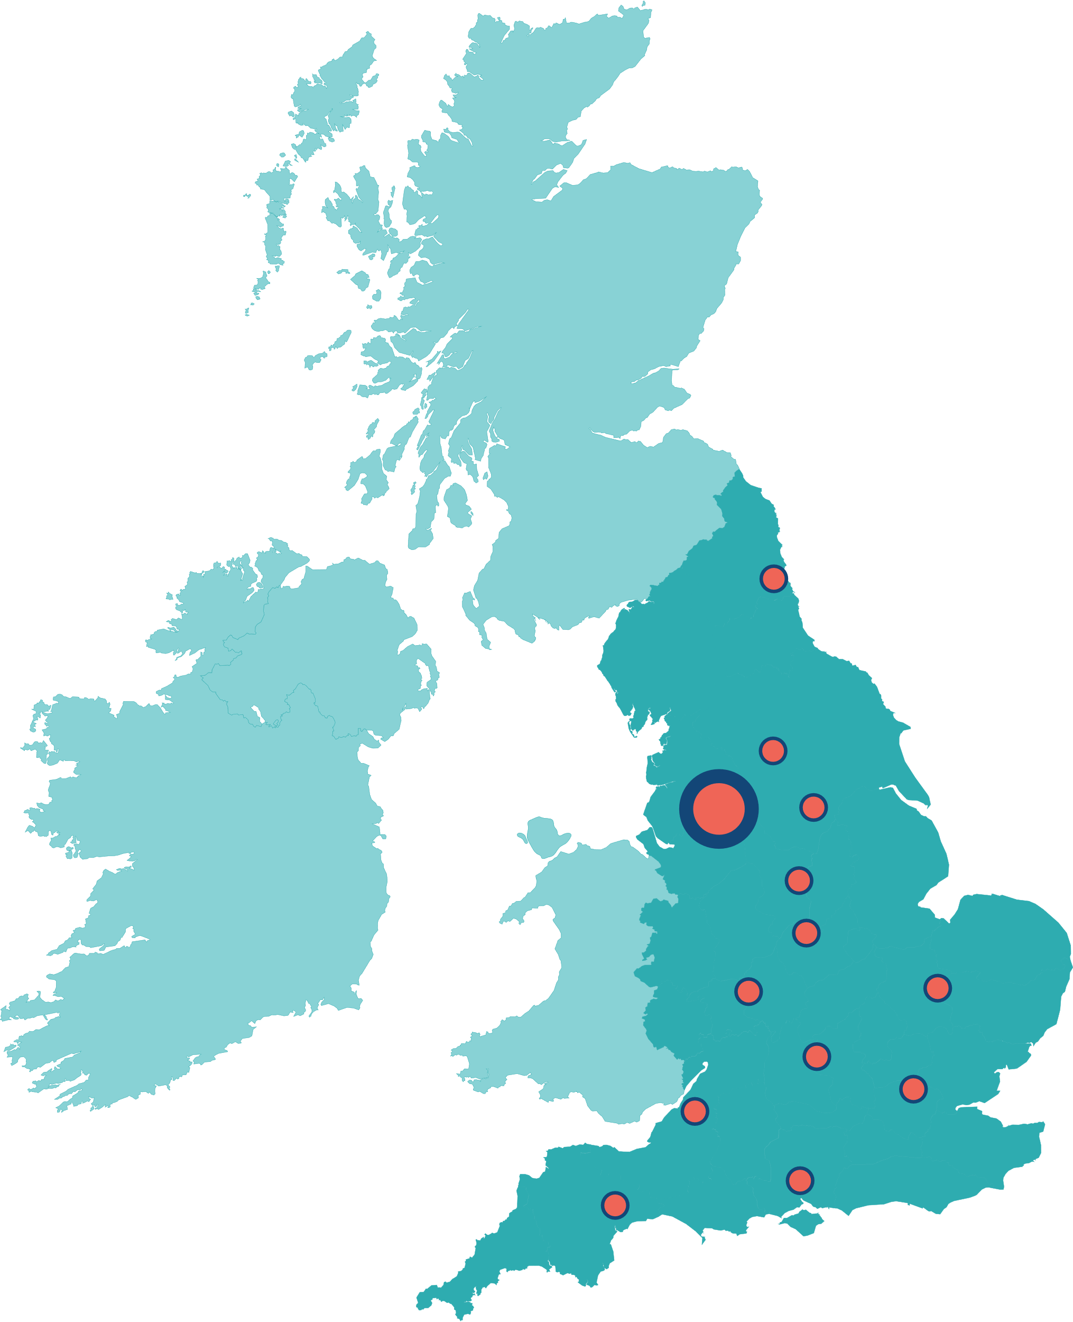

Biomedical Research Centres (BRCs)
Collaborations between Universities and NHS Trusts as leading centres of excellence in experimental medicine
National Institute for Health and Care Research (NIHR) has awarded nearly £790 million to 20 NIHR BRCs across England (2022-27)
Translating scientific breakthroughs into new treatments, diagnostics and medical technologies
Newcastle
Leeds
Manchester
Sheffield
Nottingham
Leicester
Cambridge
Birmingham
Oxford x2
London x7
Bristol
Southampton
Exeter

Slide 3
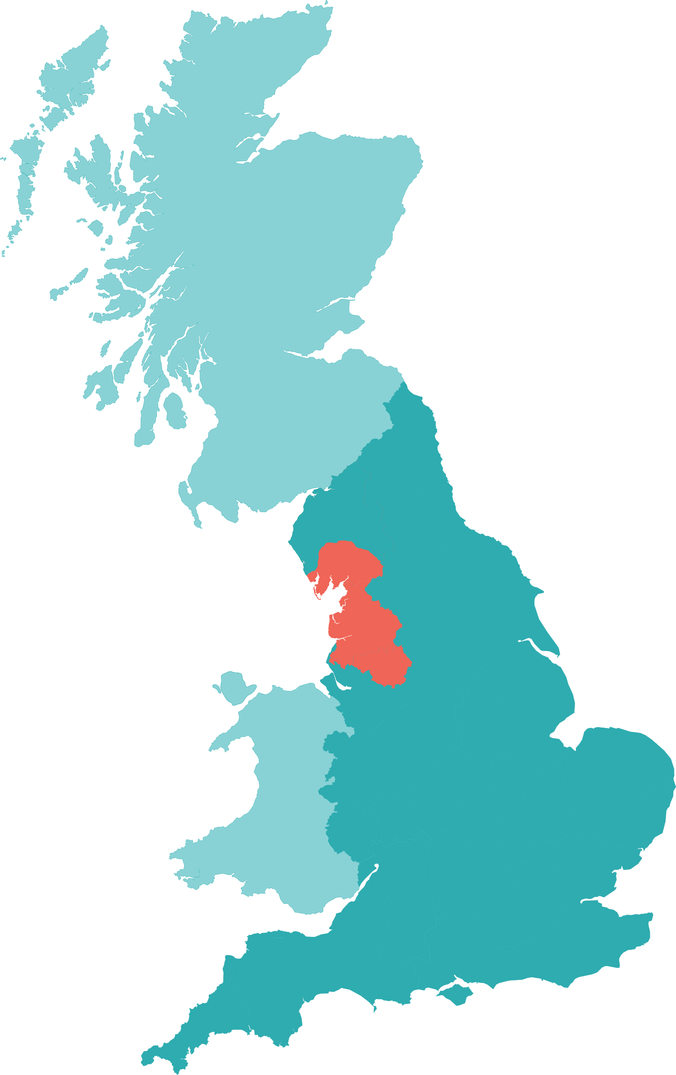


NIHR Manchester BRC 2022-2027
South Cumbria
Lancashire
Greater Manchester

Slide 4
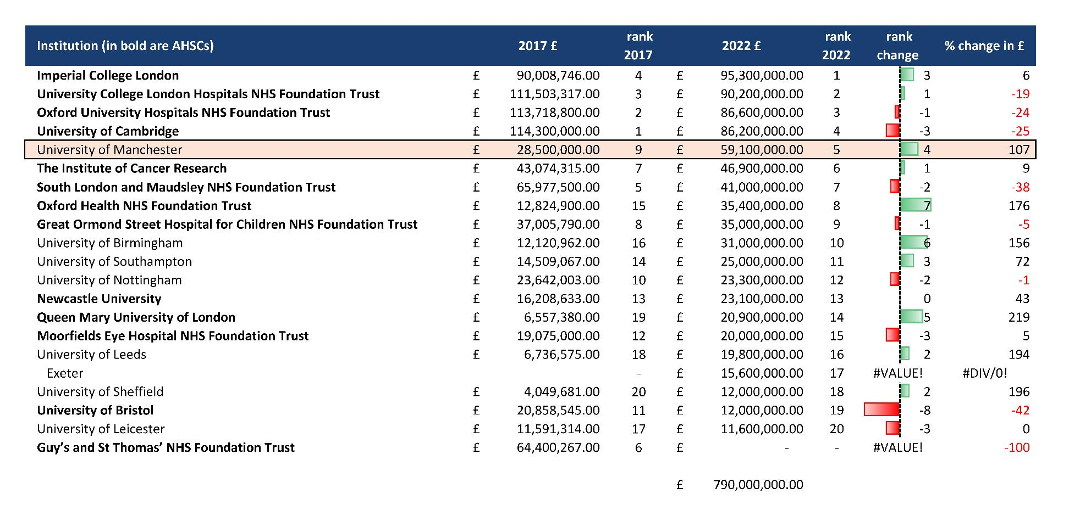

Slide 5
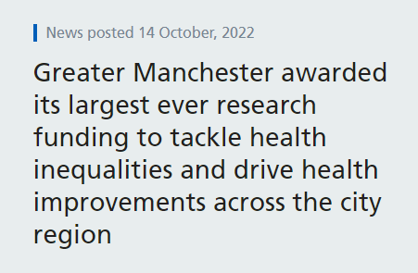
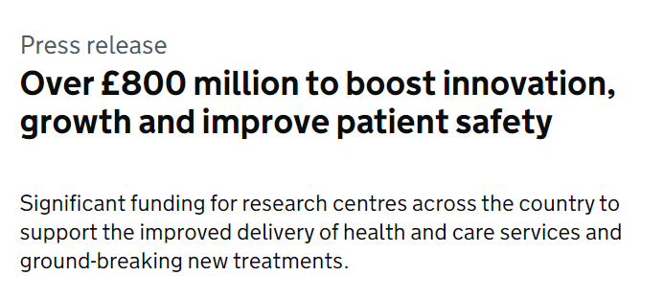
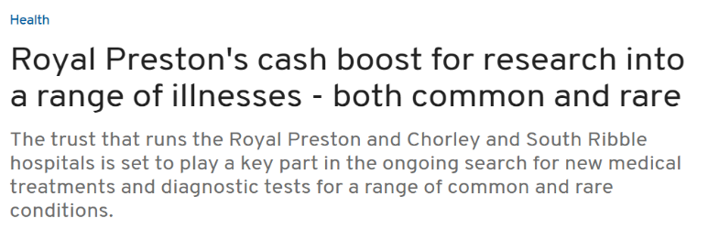
Manchester BRC
Two-stage competitive application process + interview
International panel (BRC) + individual theme peer review
More than doubled the size of the current BRC (£28.5m > £60.4m), largest BRC outside of the South-East of England
Wider geography and higher number of Themes funded
Hosted by Manchester University Hospital NHS Foundation Trust in partnership with University of Manchester, The Christie, Northern Care Alliance and expanded the partnership to Preston, Blackpool and GMMH
Strong emphasis on EDI and Inclusive Research, working with communities with highest need

Slide 6



Personalised Health & Care for all
Push
GM
Healthcare
Needs
Discovery
Science
Pull
University
Biomedical Research Centre
Later Research
Steps
Greater Manchester Needs
North West
Discover
Develop
Deploy
Health Innovation Manchester

Slide 7



Manchester BRC’s vision is to drive personalised health & care for all
Embed
Early translational research further into our communities and localities in GM, Lancashire and South Cumbria by deepening the meaningful involvement of patients, public and civic partners.
A unique national powerhouse for innovation by combining the world-leading discovery and translational science capabilities of our partnership with a strong research culture centred on a committed, diverse and inclusive workforce.
At scale, the impact of our research through our mature and integrated innovation pipeline in order to achieve measurable improvements in health and wellbeing across all sections of society in our region and beyond.
Build
Accelerate

Slide 8

Manchester BRC’s vision is to drive personalised health & care for all
We aim to:
Deliver an innovative early translational research programme
Transform disease prevention and management, at pace and scale with equity
Involve patients, public and practitioners throughout the research cycle to ensure a cohesive translational research workforce and a Team Science approach
Research:
Illnesses most relevant to the population of our region
New ways to make correct diagnoses and treat disease
How to prevent ill-health in people, whatever their background or situation

Slide 9

Grand Challenges
Addressing our region’s burden of ill-health and aligning with MAHSC, Manchester BRC’s core infrastructure will support scientific programmes designed to tackle three grand challenges:
B
asic mechanisms
o
f
disease
P
r
e
v
e
n
tion & earl
y
d
e
t
ection
P
e
r
son-
c
e
n
t
r
ed
the
r
apies, i
n
t
er
v
e
n
tions
& ca
r
e p
a
t
h
w
a
y
s
​

Slide 10



Grand Challenges
Addressing our region’s burden of ill-health and aligning with MAHSC, Manchester BRC’s core infrastructure will support scientific programmes designed to tackle three grand challenges:
B
asic mechanisms
o
f
disease
P
r
e
v
e
n
tion & earl
y
d
e
t
ection
P
e
r
son-
c
e
n
t
r
ed
the
r
apies, i
n
t
er
v
e
n
tions
& ca
r
e p
a
t
h
w
a
y
s
​

Slide 11
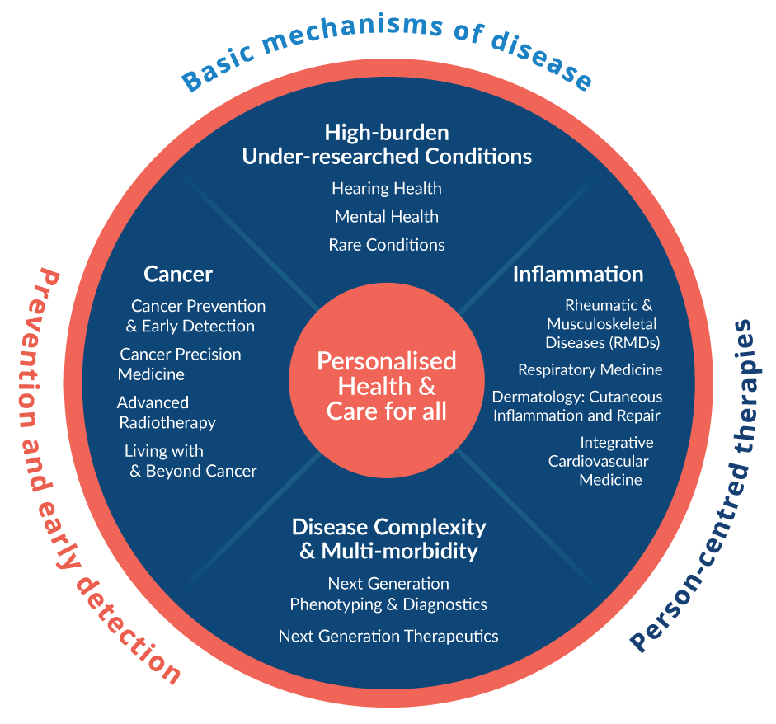
Manchester BRC Structure
4 clusters / 13 Themes
Peer support for project/
programme monitoring
Drive integration across themes
Maximise leverage of internal/
external grant funding

Slide 12
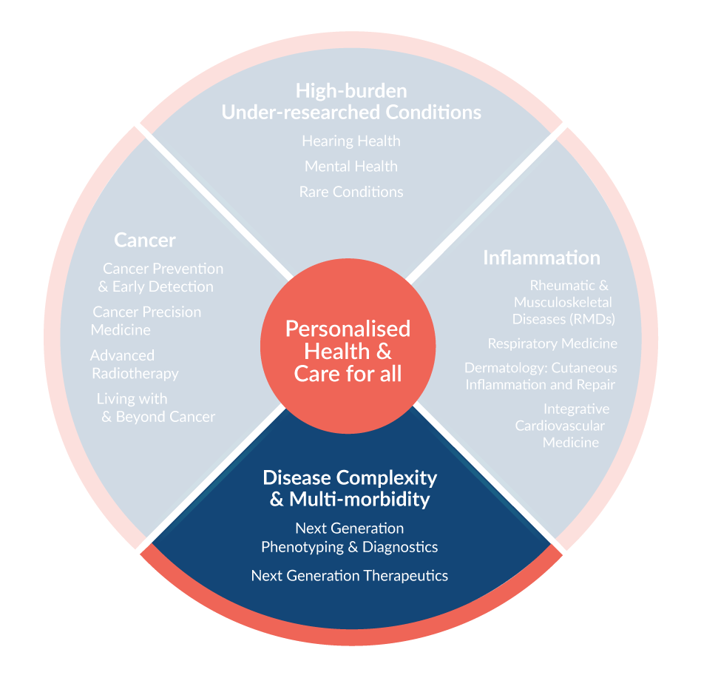
Disease Complexity and Multimorbidity Cluster
Cluster Lead:
Professor Maya Buch - Maya.Buch@manchester.ac.uk
Disease complexity:
presence of distinct subsets within a condition
A common pathways across conditions
presumes multiple long-term conditions occur within chronic diseases in a non-random way.
Aims:
To deepen understanding of disease mechanisms, including how inequalities and social factors impact biological processes
To support novel diagnostics
To provide a platform to provide early proof of concept for our novel therapeutics pipeline.

Slide 13
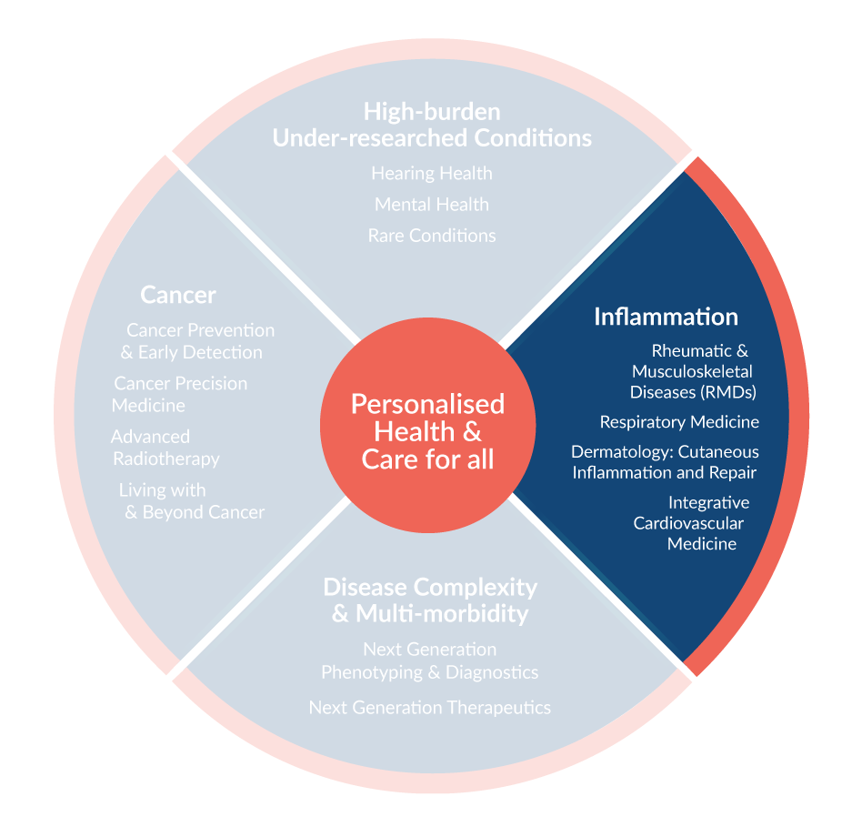
Cluster Lead:
Professor Anne Barton - Anne.Barton@manchester.ac.uk
Inflammation Cluster
Addresses several of the most common causes of death and disability in our region and nationally, in which prognosis is strongly influenced by deprivation and adverse social determinants.
Aims:
deepen understanding of the common and individual processes driving disease evolution, co-morbidities and therapeutic responses
Translate these to precision trials in patients across the life course to reduce morbidity and mortality.

Slide 14
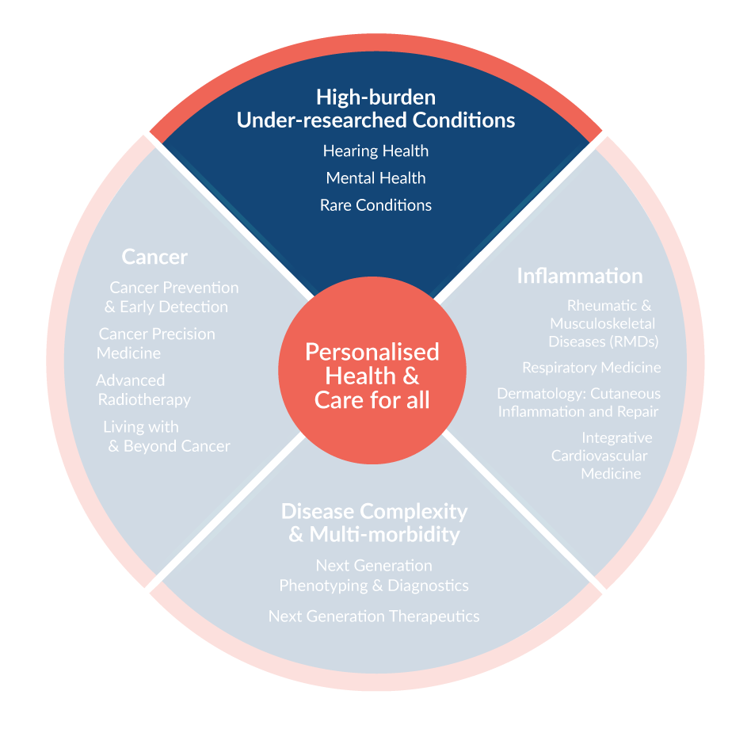
Cluster Lead:
Professor William Newman - William.Newman@manchester.ac.uk
High Burden Under Researched Conditions Cluster
Research will be undertaken on disorders that have high impact on individuals and families, but where traditionally there has been under-investment.
Plan to address areas of unmet need for people with hearing impairment, rare conditions and mental health disorders, often hidden disabilities.
Multi-professional approach:
Focusing on prevention and early diagnosis to reduce long-term disease burden
Using novel approaches including gene therapies, digital interventions and devices to transform lives.

Slide 15
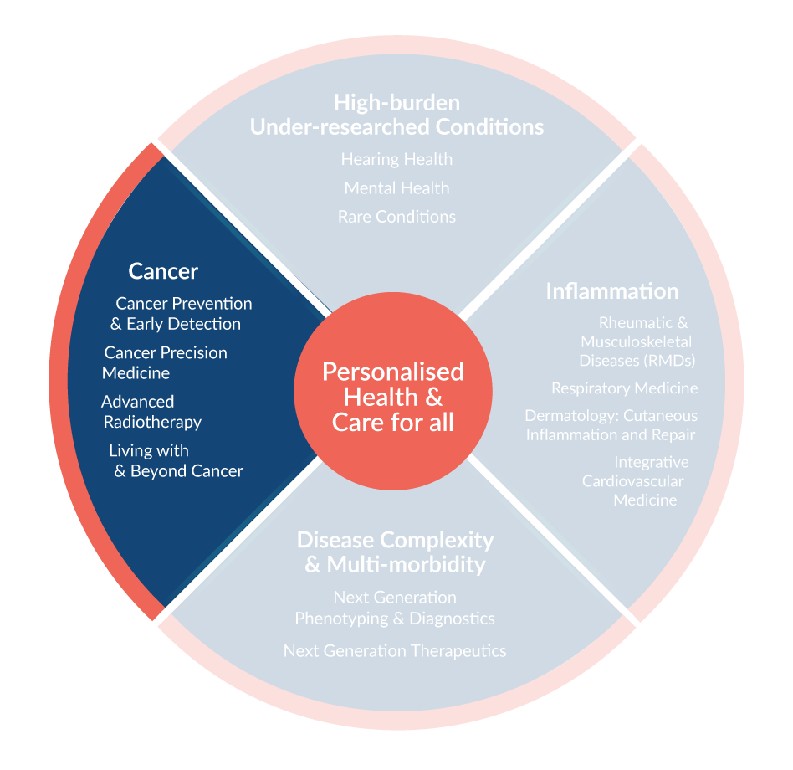
Cluster Lead:
Professor Emma Crosbie - Emma.Crosbie@manchester.ac.uk
Cancer Cluster
This Cluster addresses emerging challenges and opportunities to improve the lives of all patients with cancer, including people at risk of cancer.
It provides a patient centred approach to research in earlier diagnosis, better treatment and personalised, follow up care.

Slide 16
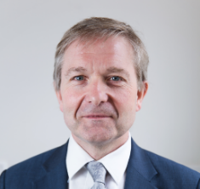
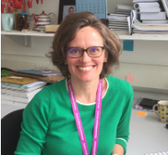

Disease Complexity Cluster:
Next Generation Phenotyping and Diagnostics
Theme Lead: Professor Graeme Black
Co-Lead: Professor Rachel Lennon
Project Manager: Mamoona Ahmed
The adoption of high throughput diagnostic techniques reduces costs, accelerates diagnosis, and improves outcomes. Greater understanding of disease complexity and multimorbidity in the context of high deprivation, social and ethnic diversity is needed to deliver more precise diagnoses to reduce the burden of ineffective treatments, enable personalised care and improve health outcomes, as underlined by the NHS Long Term Plan.
Aims:
Identify actionable insights into disease phenotypes and trajectories in diverse populations through accelerated methodological development alongside integration of complex biological and clinical datasets.
Deliver advanced diagnostic capability across the translational cycle.
Theme Lead:
Professor Graeme Black
graeme.black@manchester.ac.uk
Theme Co-lead:
Professor Rachel Lennon
rachel.lennon@manchester.ac.uk
Project Manager:
Mamoona Ahmed
Mamoona.ahmed@mft.nhs.uk

Slide 17
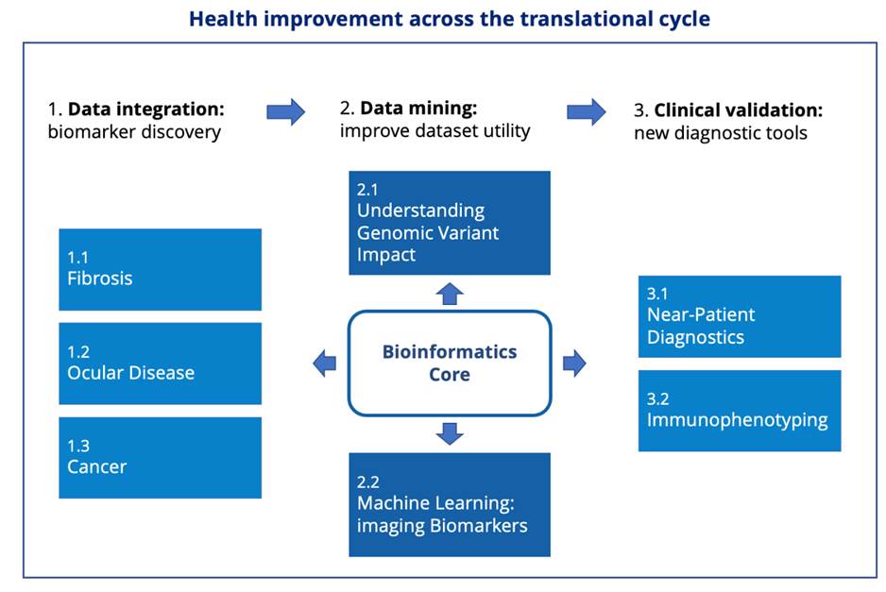
Disease Complexity Cluster:​
Next Generation Phenotyping and Diagnostics
Theme Lead: Professor Graeme Black
Co-Lead: Professor Rachel Lennon
Project Manager: Mamoona Ahmed
These aims will be delivered by three work programmes (each containing specific projects):
​
Programme 1: Multidimensional data integration to improve biomarker discovery ​
Programme 2: Data mining to advance the utility of existing diagnostic datasets ​
Programme 3: Clinical validation of translatable diagnostic methodologies ​

Slide 18
Disease Complexity Cluster:​
Next Generation Phenotyping and Diagnostics
Theme Lead: Professor Graeme Black
Co-Lead: Professor Rachel Lennon
Project Manager: Mamoona Ahmed
1. MULTIDIMENSIONAL DATA INTEGRATION TO IMPROVE BIOMARKER DISCOVERY | 2. DATA MINING TO ADVANCE THE UTILITY OF EXISTING DIAGNOSTIC DATASETS | 3. CLINICAL VALIDATION OF TRANSLATABLE DIAGNOSTIC METHODOLOGIES
Lead: David Wedge & Rachel Lennon | Lead: Graeme Black & Andrew Morris | Lead: Tracy Hussell & John Grainger
Hypothesis: 1. Improved phenotyping can detect early stages of fibrosis. 2. Integration of genomic and image data improves risk profiling 3. Multimodal tests applied across a range of ethnicities will improve prognosis across cancer types. | Hypothesis: Understanding genomic variant impact improves patient stratification and allows identification of therapeutic targets. 2. Machine learning image analysis can identify new imaging biomarkers. | Hypothesis: Near-patient diagnostics can accelerate real-time tailoring of patient management. 2. Immunophenotyping can identify disease endotype, progression and treatment response.

Slide 19
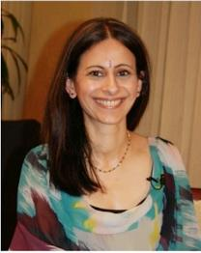
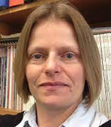
Disease Complexity Cluster:
Next Generation Therapeutics
Theme Lead: Professor Maya H Buch
Co-Lead: Professor Julie Gough
Project Manager: Mamoona Ahmed
Therapeutic advances across cancers and inflammatory diseases still have limited efficacy (40%-60%). Fibrosis contributes to nearly half of all deaths in the UK, yet effective therapeutics are lacking, and no treatments exist for most rare conditions (RC). The health impact is heightened by inequality and comorbidity of the North-West
Aims:
To prevent, effectively treat, and where feasible, cure disease, by translating our dynamic pipeline of NGTs efficiently through experimental medicine (EM) and proof of concept (PoC) trials into the most pressing and most appropriate indication(s).
Theme Lead:
Professor Maya H Buch
Maya.Buch@manchester.ac.uk
Theme Co-Lead:
Professor Julie Gough
J.Gough@Manchester.ac.uk
Project Manager:
Mamoona Ahmed
Mamoona.ahmed@mft.nhs.uk

Slide 20
Disease Complexity Cluster:​
Next Generation Therapeutics
Theme Lead: Professor Maya H Buch
Co-lead: Professor Julie Gough
Project Manager: Mamoona Ahmed
1. A METHODOLOGICAL AND INCLUSIVE PLATFORM​ | 2. DESIGNING INNOVATIVE TRIAL DESIGNS​ | 3. PRECISION THERAPEUTICS OF HIGH-RISK GROUPS AND HIGH BURDEN DISEASES​ | 4. NANOSCALE-BASED TECHNOLOGIES AND ADVANCED BIOMATERIALS TO IMPROVE HEALTH NEEDS | 5. ​ ATMPS FOR RESISTANT CANCERS AND RARE CONDITIONS​
Leads: Katherine Payne, Jayne Lawrence, Arpana Verma ​ | Lead: Matthew Parkes​ | Lead: Maya H Buch ​ | Leads: Julie Gough, Kostas Kostarelos​ | Lead: Fiona Thistlethwaite
Hypothesis: 1: Value proposition and pharmacological/pharmaceutical evaluation improve NGT success 2: Widening access to NGT trials delivers more widely applicable outcomes ​ ​ | Hypothesis: 1: Personalised outcome measures deliver efficient trials​ 2: Molecular stratification and pharmacogenomics enable endotype-driven innovative trials​ | Hypothesis: 1: Personalising therapies to high-risk groups improves outcomes​ 2: Novel/repurposed therapeutics can treat refractory disease​ 3: High-throughput compound screening can target fibrosis​ | Hypothesis: 1: Graphene nanomaterials provide opportunity in neurological disorders​ 2: Nanomaterials enhance drug delivery systems​ 3: Advanced biomaterials provide local therapeutic strategies across diseases | Hypothesis : ​1: Engineered cells/cell-based delivery systems enhance immunotherapy ​ 2: Gene editing techniques can treat/cure rare conditions

Slide 21
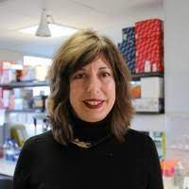
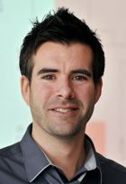
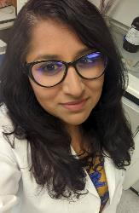
Inflammation Cluster:​
Rheumatic Musculoskeletal Diseases (RMD)
RMDs affect >18 million people in the UK, account for >20% of GP consultations and societal costs are ~2% GDP; RMDs have poorer outcomes in lower socioeconomic and minority populations. Inflammatory RMDs are associated with multi-morbidity, premature mortality and have treatment non-response rates >30%. Osteoarthritis (OA) and chronic back pain lack effective disease modifying interventions, yet account for more working-age disability than any other disease. The prevalence of RMDs and chronic pain inversely correlates with household income, therefore widening health inequities in already deprived communities.
Aim: To improve the prevention and treatment of RMDs and associated co-morbidities for all by developing personalised health and care strategies.
Theme Lead: Anne Barton Anne.Barton@manchester.ac.uk | Co-Lead: Andrew Morris Andrew.Morris-5@manchester.ac.uk | Project Manager: Nisha Nair Nisha.Nair@manchester.ac.uk

Slide 22
Inflammation Cluster:​
Rheumatic Musculoskeletal Diseases
1. PREVENTION OF DISEASE AND CO-MORBIDITY | 2. DEFINING TRACTABLE MOLECULAR ENDOTYPES USING MULTI-OMICS | 3. TRANSLATION OF ADVANCES FROM BASIC SCIENCE TO IMPROVE TREATMENT OF DISEASE | 4. OPTIMISING RESPONSE TO AVAILABLE THERAPIES
Lead: Maya Buch | Lead: Kimme Hyrich & John McBeth | Lead: Terence O’Neill | Lead: Ian Bruce
Focus on prevention of disease and co-morbidities will reduce disease burden and multi-morbidity in older and under-researched populations. | Study conditions overrepresented in minority communities and chronic RMD conditions in children, and develop person-centred care strategies to improve outcomes. | Rates of back pain and OA in the North-West are higher than the national average. By developing and testing novel therapeutics for conditions affecting people of working age, economic activity will be enhanced. | Implement validated biomarkers to inform intelligent therapy selection; optimising adherence and harnessing digital tools. Deliver more holistic, personalised and cost-effective patient management for all.

Slide 23
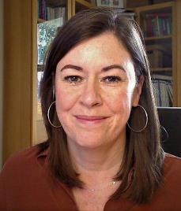
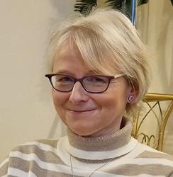
Inflammation Cluster:​
Respiratory
Respiratory ill-health presents a huge unmet need with significant morbidity, mortality and health inequalities linked to high levels of deprivation. Reducing mortality and morbidity of respiratory disease is our overarching aim.
Our theme capitalises on our international leadership in Chronic Obstructive Pulmonary Disease (COPD), respiratory symptoms, infection, asthma and is nested within one of the largest clinical respiratory department in the UK .
Our work is shaped in collaboration with our respiratory patients through VOCAL, Asthma UK, and Let's Talk About Cough.
Aims: to develop novel biomarker-led diagnostic and prognostic strategies, facilitating precision therapeutic approaches to improve outcomes for patients.
Co Theme Lead: TBC
Acting Co Theme Lead:
Jacky Smith
Jacky.Smith@manchester.ac.uk
Project Manager:
Zoe Talks
Zoe.Talks@mft.nhs.uk

Slide 24
Inflammation Cluster:​
Respiratory
Precision diagnostics & therapeutics in airways disease | 2. Understanding and improving airway symptoms and function | 3. Exacerbation mechanisms and diagnosis | 4. Precision Therapy in Respiratory Infections/Exacerbations
Lead: Clare Murray | Lead: Jacky Smith | Lead: Tim Felton | Lead: Dave Singh
Apply precision approaches, to reduce treatment burden in asthma in underserved populations. | Identify treatments for respiratory conditions lacking licensed therapies and assess pollution risks relevant to our GM population. | Reduce risk of acute respiratory events and AMR, prevalent in our underserved population | Apply precision approaches to host-pathogen interactions in complex respiratory infections to develop person-centred care and improve outcomes.

Slide 25
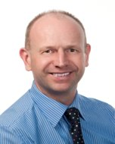
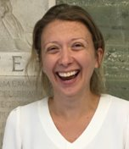
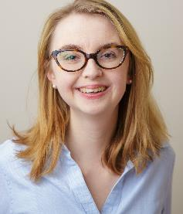
Inflammation Cluster:
Dermatology - Cutaneous Inflammation and Repair
Skin diseases and complex wounds are among the most common, chronic, and quality-of-life-reducing conditions in the UK. They account for approximately 30% of GP consultations, span all ages and cost the NHS c.£5b annually. Greater Manchester’s (GM) population of 2.8 million is served by the largest UK clinical dermatology department and an internationally recognised dermatology research group containing two NIHR Senior Investigators and the 3rd and 11th most-cited dermatologists worldwide. Capitalising upon our global leadership and links with other Manchester BRC Themes and BRCs we will address three core questions across our five Programmes:
  What are the common pathways driving selected inflammatory skin diseases and wound healing?
  Can we predict disease course and therapeutic response?
  Can we target mechanisms to optimise skin condition prophylaxis and management?
Theme Lead: Richard Warren Richard.Warren@mft.nhs.uk | Co-Lead: Jo Dumville Jo.Dumville@manchester.ac.uk | Project Manager: Kate Kuyt Katherine.Kuyt@mft.nhs.uk

Slide 26
Inflammation Cluster:
Dermatology - Cutaneous Inflammation and Repair
1. COMPLEX WOUNDS | 2. INFLAMMATORY HAIR DISEASE | 3. PHOTODERMATOSES | 4. PSORIASIS | 5. SKIN CANCER
Lead: Jo Dumville | Lead: Matt Harries | Lead: Lesley Rhodes | Lead: Richard Warren | Lead: Amaya Viros
Understanding the prognostic power of biomarkers for healing and to develop prognosis models that will identify people at risk of poor wound outcomes. To identify candidate therapies to promote wound healing | Build on current BRC outcomes focusing on hair follicle immune privilege restoration and prevention/repair of stem cell immunopathology | Identify how individual skin microbiome modifies responses to solar UVR exposure and defining how ethnicity/skin-type influences phenotype and photoprotective behaviour | Identify and develop models to study pathways targeted by current therapeutics which demonstrate risk variants for psoriasis; and to identify genetic changes that impact drug-targeted pathways | Identify how UVR changes the cutaneous molecular and immune landscape and factors that promote SCC progression. Establishing biomarkers of risk by investigating normal, premalignant and SCC tissue before and after chemoprevention and therapies

Slide 27
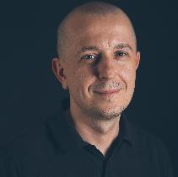
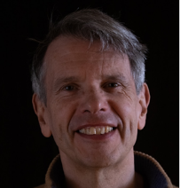
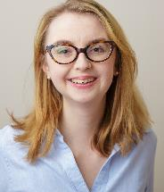
Inflammation Cluster:
Integrative Cardiovascular
New translational diagnostic and therapeutic opportunities will be delivered by molecular re-defining of cardiovascular
disease endotypes and mechanisms. We will achieve this by applying blood, tissue and single-cell poly-omics,
immunophenotyping, and imaging technologies in large and clinically well-phenotyped cohorts.
Interdisciplinary Collaborations - Strong cross-theme and cross-cluster collaborations with Next Generation Phenotyping and Diagnostics, Next Generation Therapeutics, Rheumatic-Musculoskeletal Diseases Living with Cancer, Rare disease
Expertise - BHF Accelerator Award in “Integrative Physiology”, BHF Four-Year PhD Scheme, State-of-the-art 3T research magnet, strong industry partnerships, unique resources including disease cohorts, curated human tissue collections and expertise in multi-centre clinical trials
Capacity Building - Expanding capacity across key disciplines where cardiovascular disease is an important outcome, including: fetal and maternal medicine; rheumatology; genomic medicine; nephrology; and stroke medicine.
Resource/expertise building at other North-West centres including Blackpool Teaching Hospitals NHS Foundation Trust
Investing into the next generation of leaders in cardiovascular medicine
Co-Theme Lead: Maciej Tomaszewski
maciej.tomaszewski@manchester.ac.uk
Lead: Bernard Keavney
bernard.keavney@manchester.ac.uk
Project Manager: Kate Kuyt
Katherine.Kuyt@mft.nhs.uk

Slide 28
Inflammation Cluster:
Integrative Cardiovascular
Programme 1: Hypertension | Programme 2: High cardiovascular risk conditions | Programme 3: Acute coronary syndromes | Programme 4: Congenital heart disease and inherited cardiac conditions
Lead: Maciej Tomaszewski | Lead: Stuart Allan | Lead: Rick Body | Lead: Bernard Keavney
A comprehensive and integrated approach to phenotyping in patients with high blood pressure and modern multi-omics of human kidney and vascular tissues will illuminate novel therapeutic interventions and reduce progression to hypertension-mediated organ damage. | Novel imaging, immunophenotyping and modern “omics” will enable precision diagnostics and personalised treatment, determine the prognostic relevance of specific endo-phenotypes, and inform the conduct of novel trials for patients with immune-mediated inflammatory diseases (IMIDs), heart failure with preserved ejection fraction (HFPEF), chronic kidney disease (CKD), and stroke. | Novel diagnostic approaches to management of acute coronary syndrome in the Emergency Department will improve patient outcomes. | Genotype-phenotype studies in congenital heart disease will yield actionable knowledge about aetiological understanding of CHD and its comorbidities. Clinical trials and precision clinical phenotyping will identify new treatments for rare inherited cardiac conditions.

Slide 29
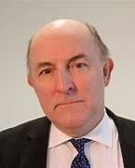
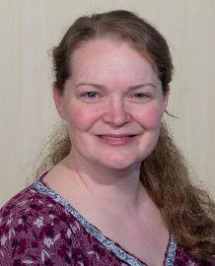
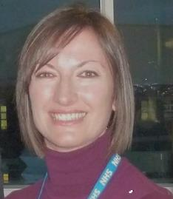
Cancer Cluster:
Cancer Prevention & Early Detection
Focus on cancers at higher incidence/mortality in Greater Manchester and most amenable to prevention and early detection (PED) strategies. Our team science approach will foster an environment where the best clinical and scientific minds across disciplines work together with patients and the public to improve the health of our population and beyond.
Aims:
To identify those at high risk of cancers amenable to PED
To develop acceptable, cost-effective, non-invasive tests for ED and tailor prevention interventions to individuals
To improve our understanding of health inequity
Theme Lead: Gareth Evans
Gareth.Evans@mft.nhs.uk
Co-Lead: Emma Crosbie
Emma.Crosbie@manchester.ac.uk
Project Manager: Emma Thorpe
Emma.Thorpe@christie.nhs.uk

Slide 30
Cancer Cluster:
Cancer Prevention & Early Detection
RISK | 2. EARLY DETECTION | 3. ACCESS TO SCREENING | 4. PREVENTION
Lead: Gareth Evans | Lead: Emma Crosbie | Lead: David French | Lead: Sacha Howell
Multimodal risk prediction models (RPMs) can stratify individuals according to their cancer risk for targeted PED strategies | Non-invasive cancer biomarkers can triage symptomatic patients for invasive diagnostic testing and show potential as screening tools for high-risk populations | Access to cancer screening by underserved populations can be improved by identifying and minimising barriers to attendance, thereby reducing health inequalities | Next generation prevention strategies can reduce cancer risk by targeting specific drivers of carcinogenesis

Slide 31
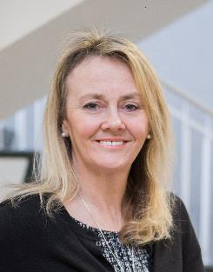
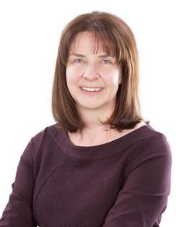
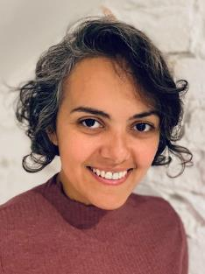
Cancer Cluster:
Cancer Precision Medicine
Personalised therapies improve outcomes but inevitably drive acquired resistance that we must anticipate and counteract. We must also holistically understand the patients whose duration and quality of life we seek to improve. We will consider population diversity, co-morbidities and polypharmacy, responding to patients’ voices throughout our research.
Leadership of Phase I-IV trials within The Christie, coupled to our internationally recognised translational research and vanguard digital approaches, will optimise in real-time when personalised treatment is started, stopped, paused or changed, ensuring no patient is left behind.
Aim: Improved patient outcomes with optimised cancer precision medicines.
Theme Lead: Caroline Dive
Caroline.Dive@manchester.ac.uk
Co-Lead: Fiona Blackhall
Fiona.Blackhall@nhs.net
Project Manager: Ekram Aidaros-Talbot
Ekram.Aidaros-Talbot@manchester.ac.uk

Slide 32
Cancer Cluster:
Cancer Precision Medicine
Expansion of UK Cancer precision medicine early phase trials | Personalising Immunotherapy | Counteracting Treatment Resistance | Digital Clinical Trials with patients as co-researchers
Lead: Matthew Krebs | Lead: Santiago Zelenay | Lead: Fiona Blackhall | Leads: Donna Graham & Andre Freitas
Access to and efficacy of targeted therapeutics will increase within the National early phase trials we lead | Predictive biomarkers of immunotherapy response will optimise risk/benefit of treatment and reduce treatment costs. | Comprehensive molecular analysis of tumours and tumour microenvironments will inform improved treatment for patients with recalcitrant cancers. | Our digital approach will revolutionise patient care via community/in home-based clinical trials.

Slide 33
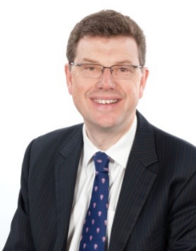
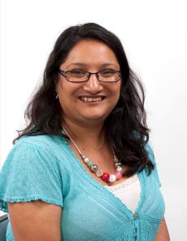
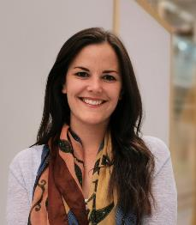
Cancer Cluster:
Advanced Radiotherapy
Radiotherapy is the most important non-surgical treatment, received by 50-60% of cancer patients. Co-led by an NIHR Senior Investigator (Tim Illidge) and working alongside international leaders in clinical research, biology and physics, we translate experimental medicine into the clinic and change practice for patient benefit improving outcomes and survival. Our research shapes national/ international radiotherapy guidelines.
Aim: To optimise and personalise advanced radiotherapy regimens to increase cures and reduce side-effects.
Co-Lead:
Tim Illidge
Tim.Illidge@manchester.ac.uk
Co-Lead:
Ananya Choudhury
Ananya.Choudhury@nhs.net
Project Manager:
Lois Gardner
lois.gardner@manchester.ac.uk

Slide 34
Cancer Cluster: Advanced Radiotherapy
1: PRECISION RADIOTHERAPY | 2: IMMUNE RESPONSE TO RADIOTHERAPY | 3: PROTON THERAPY | 4: HYPOXIA BIOMARKERS | 5: MR LINAC & FUNCTIONAL ADAPTATION
Lead: Corinne Faivre-Finn | Lead: Tim Illidge | Lead: Karen Kirkby | Lead: Ananya Choudhury | Lead: Cynthia Eccles
Use big data infrastructure to ‘learn from every patient’ to inform new treatment and follow-up methods; inclusive research for all patient groups (older, frailer, socially deprived & minority groups). | Investigate how immune response to radiotherapy dictates normal tissue toxicity affecting quality-of-life; identifying on-treatment immune biomarkers of radiotherapy response to improve outcomes. | Optimisation of proton therapy delivery and drug combinations and implementing outcome prediction models to improve tumour control and decrease long-term side-effects for paediatric & teenage, young adult patients. | Identify hypoxic tumours using tissue-specific tests to select patients for established but under utilised hypoxia-targeted treatments with radiotherapy to improve patient outcomes. | Use real-time physiological data to improve the precision of radiotherapy delivery; defining prognostic biomarkers to optimise treatment, improve survival, reduce toxicity & enhance quality-of-life.

Slide 35
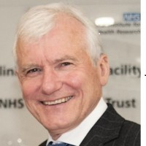
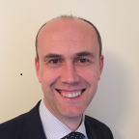
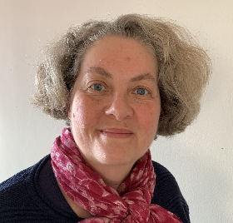
Cancer Cluster:
Living with and Beyond Cancer
Over 300,000 people in the North-West will be living with the short and long-term consequences of cancer by 2030. Personalised interventions are required to reduce the risk of events including cardiovascular morbidity/mortality, bone fracture, cancer recurrence and the development of second cancers.
Aim: To optimise identification and personalise treatments, reducing the burden of multiple long-term conditions after cancer therapy and improve morbidity and mortality.
Theme Lead:
Professor John Radford ​
john.radford@manchester.ac.uk​
​
Theme Co-lead:​​
Professor Christopher Miller​​
christopher.miller@manchester.ac.uk ​​
Project Manager:​​
Louise James ​​
Louise.James22@nhs.net​​

Slide 36
Cancer Cluster:
Living with and Beyond Cancer
1: CARDIOVASCULAR HEALTH | 2: BONE HEALTH | 3: RECURRENT & SECOND CANCERS
Lead: Chris Miller | Lead: Claire Higham | Lead: Kim Linton
Development of individual risk estimates for cardiovascular morbidity and mortality leading to personalised diagnostics and therapeutics; improving cardiovascular health in cancer patients. | Optimising bone health in cancer patients by identification of those at high risk of impaired bone health/fractures to facilitate targeted interventions for prevention and treatment. | Earlier detection of second, treatment related cancers or recurrence to improve outcomes for high risk patients

Slide 37
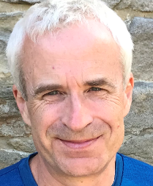
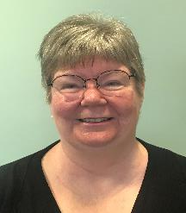
High Burden Under-Researched Cluster:​
Hearing Health
Tackle the challenges of hearing loss across the social spectrum; addressing NIHR priorities, and the government’s levelling-up agenda. Our service users, clinical networks, industry and charity collaborations shape our priorities.
Aims:
To improve prevention, diagnosis, treatment, and management of hearing loss and co-morbidities
To fundamentally shift the emphasis from hearing loss to hearing health
Theme Co-Lead: Gabrielle Saunders
Gabrielle.saunders@manchester.ac.uk
Theme Co-Lead: Chris Plack
Chris.Plack@manchester.ac.uk
Project Manager: Cath Wright
Cath.Wright@manchester.ac.uk

Slide 38
High Burden Under-Researched Cluster:​
Hearing Health
PREVENTION | 2. DIAGNOSIS: TOOLKIT | 3. DIAGNOSIS: CLUSTERS | 4. TREATMENT | 5. INCLUSION SCIENCE
Lead: Karolina Kluk | Lead: David Moore | Lead: Rebecca Millman | Lead: Gabrielle Saunders & Michael Stone | Lead: Chris Armitage
Identification of genetic, environmental and immunological factors causing hearing loss will inform therapies that mitigate risk | Innovative diagnostic tools designed for more sensitised and precise detection will enhance personalised care | Understanding mechanisms that link hearing loss with co-morbidities of dementia and diabetes will improve diagnosis, prevention and management of all three | Personal digital technology, remote care, and person-centred-metrics can be used to optimise hearing health outcomes and monitor general health | Behavioural science approaches will improve identification of disease, uptake and outcomes of treatments

Slide 39
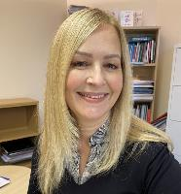

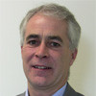
High Burden Under-Researched Cluster:​
Mental Health
First core area of mental health theme work | Second core area of mental health theme work
The developmental neuroscience sub-theme aims to understand how: Adverse childhood experiences lead to distinct immunophenotypes, neurobiological and cognitive markers in adolescence that predict development of mental health problems Non-Invasive Brain Stimulation (NIBS) impacts cognitive and phenotypic (autism/ADHD) outcomes through impact on GABA/Glutamate E/I modulation | The digital and data sub-theme aims to understand: The impact of covid-19 on antecendent inequalities across different individuals, families and neighbourhoods How real-time ambulant symptom monitoring (ecological momentary assessments) can be used to elucidate mechanisms triggering psychotic symptoms in people with severe mental health problems
Poor mental health plays a key part in all health outcomes, with lower life expectancy, high rates of suicide, poor employment and social outcomes.
The aim of the mental health theme is to:
Increase understanding of key neurobiological, social & psychological mechanisms driving the onset, development and maintenance of mental health problems.
Use epidemiology and novel digital and neuroscience techniques to generate better, more fine-tuned and targeted treatments.
Increase understanding of how mental health may manifest in combination with the environment and physical health disorders across the lifespan.
Theme Lead:
Professor Gillian Haddock
Gillian.Haddock@manchester.ac.uk
Theme Co-lead:
Professor Shon Lewis
shon.lewis@manchester.ac.uk
Project manager:
Lee Mulligan
lee.mulligan@manchester.ac.uk

Slide 40
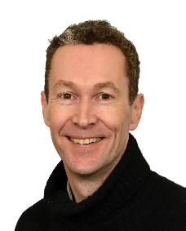
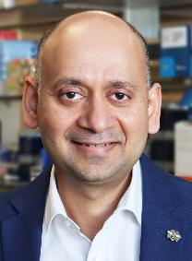
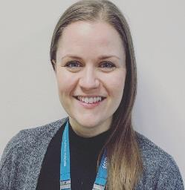
High Burden Under-Researched Cluster:​
Rare Conditions
Over 3.5 million people in the UK are affected by one of >7000 rare conditions (RCs). Two-thirds of RCs cause chronic disability; 3 in 4 affect children, 3 in 4 have a genetic basis, >1/2 cause early death and most have no treatment. Different RCs can affect individuals in many ways, however similar challenges are common to all RCs - including the need for timely diagnosis; defining relevant clinical outcome measures, and personalised, disease-specific effective treatments. RCs impact patients across all ages, gender, socio-economic and ethnic backgrounds. Guided by our inclusive, vibrant, patient group, we have established the Manchester Rare Conditions Centre to provide coordinated, expert clinical care for children and adults with RCs. This Centre will provide an ideal environment for research programs in this theme.
Aims: To improve the diagnosis, prevention and treatment of Rare Conditions in affected individuals and families
Theme Lead: Bill Newman William.Newman@manchester.ac.uk | Co-Lead: Siddharth Banka Siddarth.Banka@manchester.ac.uk | Project Manager: Rachel James Rachel.James@mft.nhs.uk

Slide 41
High Burden Under-Researched Cluster:​
Rare Conditions
1: IMPROVED DIAGNOSIS, UNDERSTANDING, AND PREVENTION OF RCS | 2: UNDERSTANDING THE IMPACTS AND OUTCOMES OF RCS | 3: NOVEL TREATMENTS FOR RCS
Lead: Gareth Evans Sid Banka | Lead: Ramona Moldovan, Katherine Payne | Lead: Simon Jones, Rob Wynn
Our focus on early diagnosis and prevention of RCs will aid more effective clinical care and inform future treatments. | By defining outcomes relevant to RCs we will be able to design studies to establish real benefits for individuals affected by RCs. | New approaches to treatment of RCs including gene therapies will improve patients’ lives.

Slide 42






The BRC Partnership
NHS Trust | Themes
 | Next Generation Phenotyping and Diagnostics, Next Generation Therapeutics, Rheumatic Musculoskeletal Diseases, Respiratory, Integrative Cardiovascular, Cancer Prevention and Early Detection, Rare Conditions
 | Cancer Precision Medicine, Radiotherapy, Living with and beyond cancer
 | Leads in Dermatology and Wound Healing, Rheumatic Musculoskeletal Diseases, Cardiovascular Medicine (Additional specialist services include neuroscience, major trauma, intestinal failure, head and neck, cancer)
 | Mental Health, Complex trauma and resilience, psychosis, youth mental health, perinatal mental health, suicide prevention, delivering psychological therapies in common mental illness
 | Cardiology and Haematology, Cancer
 | Cancer, Next Generation Phenotyping and Diagnostics, Respiratory

Slide 43
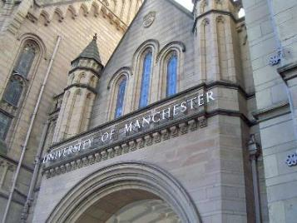
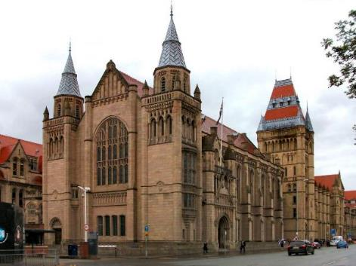
University of Manchester
The University of Manchester is a powerhouse of research and is ranked among the leading research universities globally (top ten for social and environmental impact, Times Higher Education, 2022).
Their focus is on achieving excellence and impact across their diverse portfolio of cross-disciplinary research activities. Their research teams include two Nobel Laureates, Regius Professors, and celebrated Fellow of Academies and Learned Societies working with their research staff, postgraduate researchers and technicians in a world-class research environment.
They also work with businesses of all sizes, not-for-profit organisations, and regional and national government. The University is recognised as the partner of choice for many large corporations including AstraZeneca and Siemens. These partnerships span different disciplines and are governed by framework agreements covering research, recruitment and PhD training.
Manchester BRC is hosted by Manchester University NHS Foundation Trust (MFT), in partnership with The University of Manchester (UoM). This partnership:
    Successfully managed the transition of our Musculoskeletal Biomedical Research Unit (£5.5m) to our previous Manchester BRC (£28.5m)
    Hosts a significant level of NIHR-infrastructure (BRC, CRF, ARC, CRN, ECMC, UKCRF network total = £151m over last five years, plus £10m in NIHR programme grants)
    MFT and UoM are founding partners in the Manchester Academic Health Science Centre (MAHSC).
          MFT is the legal host for our Academic Health Science System - Health Innovation Manchester (HInM)
          MFT established the Greater Manchester NIHR Oversight Board to ensure our research and innovation capabilities align and provide excellence and value for money for NIHR.
          Current partners (The Christie, SRFT/NCA) are embedded within the BRC Governance Structure and new Partners (GMMH, Blackpool and LTHTr) are closely aligned.

Slide 44

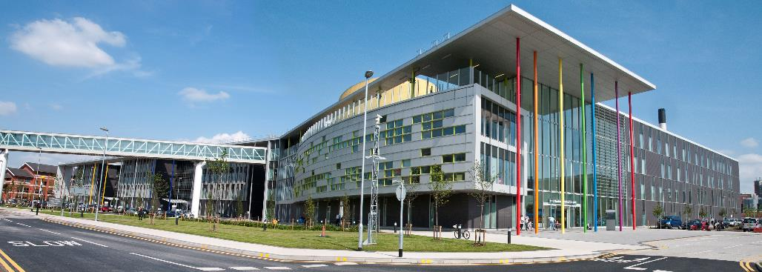
Manchester University NHS Foundation Trust
MFT is the largest provider of acute adult and children’s services in England and has more specialised services commissioned than any other Trust.
Largest NHS Foundation Trust in England, employing over 23,000 staff. Ten hospitals and community services across Manchester and Trafford across six separate sites.
Primary provider of hospital care to approximately 750,000 people in Manchester and Trafford, and the single biggest provider of specialised services in the North West of England.
Lead provider for a significant number of specialised services including Breast Care, Vascular, Cardiac, Respiratory, Urology Cancer, Paediatrics, Women’s Services, Ophthalmology and Genomic Medicine.
MFT is host to one of the largest NIHR portfolios in the country.
MFT’s R&I is supported by more than 600 staff, including an integrated Research Office, Clinical and Non-Clinical Research Delivery Teams, and an Innovation Team.

Slide 45

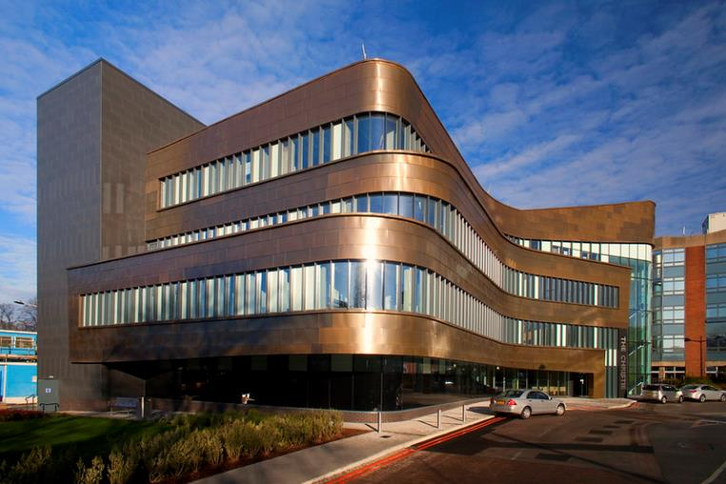
The Christie NHS Foundation Trust
Largest single-site comprehensive cancer centre in Europe, providing treatment services to 3.2million people across Greater Manchester and Cheshire and receiving over 15,000 new cancer patients each year.
One of the top performing NHS Trust’s in England having been rated as Outstanding by the CQC in two successive assessments.
Provides an extensive range of other NIHR funded infrastructure including the oncology arm of the Manchester Clinical Research Facility (CRF), a substantial investment in clinical trial resource through the Greater Manchester (GM) Clinical Research Network (CRN); is a key partner of the Greater Manchester Applied Research Collaboration (ARC) and a key contributor to the GM Patient Safety Translational Research Centre (PSTRC).
Hosts the new Paterson Institute for Cancer Research (£150m); a dynamic interface for researchers co-located with clinical services (CRUK MI) and MCRC.

Slide 46





Northern Care Alliance
(NCA)
Main provider of acute and secondary care to over one million people in the North of Greater Manchester and beyond, as well as delivering a range of community, primary and social care. They provide specialist services such as: Neurosciences, Major Trauma, Renal, Intestinal Failure, Dermatology, Head & Neck and OG cancer with aims to develop capacity in other key strategic areas, such as Cancer, via research being undertaken within the Geoffrey Jefferson Brain Research Centre.
Strong focus on ensuring research is embedded in communities, representing over a quarter of England’s population, and helping address the extremes of UK health inequalities; with over half of the North having a lower life expectancy than the worst area of the South.

Slide 47


Greater Manchester Mental Health NHS Foundation Trust
Provides inpatient and community-based mental health care for people living in Bolton, Manchester, Salford, Trafford and Wigan and a wide range of specialist mental health and addiction services across Greater Manchester, the northwest of England and beyond.
Over 6,400 members of staff deliver services from around 160 locations.
Sees around 65,000 service users p/a across very diverse communities which all BRC themes would be able to access encouraging cross-theme working
GMMH attracts over £4.5m in NIHR grant funding with 10 research units: Psychosis, Dementia, Complex Trauma and Resilience, Youth Mental Health, GM.Digital, Suicide Risk and Safety, Specialist Perinatal, Mental Health Nursing, Psychological Therapies for Anxiety and Depression, EDI
Each research unit has service user/lived experience researchers and contributors as part of their core infrastructure to deliver high quality user-led research, including clinical trials of interventions developed by lived experience stakeholders.
In 20/21 recruited over 2600 participants to NIHR portfolio studies.
Clinical trials have directly led to NICE Guideline recommendations for delivery of specific interventions.
Hosts the University of Manchester’s first ever NIHR Research Professorship.

Slide 48


Blackpool Teaching Hospitals NHS Foundation Trust
Situated on the west coast of Lancashire, with its main services and settings covering the local authority areas of Blackpool, Fylde and Wyre.
Part of Lancashire and South Cumbria ICS (population of 1.6 million people).
Acute services provided in three main hospitals to around 354,000 local residents
Provider of specialist tertiary care for Cardiac and Haematology services, delivers a wide range of community health services to over 445,000 residents including those in North Lancashire.
Provides urgent and emergency care services to a further estimated 18 million people who visit the seaside resort of Blackpool each year.
The Trust delivers a broad portfolio of NIHR research running over 100 studies per year across 20 clinical specialties, with dedicated research team. Recruited over 5500 participants in the last 2 years alone, ranking in the top 5 Trusts across the NorthWest Coast CRN
Research strength include Cardiovascular disease, Oncology and Haematology. Also Respiratory, Diabetes, Gastroenterology, Acute Medicine, Surgery and Pathology.
Designation as one of only five NIHR Patient Recruitment Centres (PRC) nationally.

Slide 49


Lancashire Teaching Hospitals NHS Foundation Trust
Major acute healthcare service provider to over 350,000 people
Regional specialist centre offering care to around 1.8 million people in Lancashire and South Cumbria for: Adult Allergy & Clinical Immunology, Cancer (including radiotherapy, drug therapies and cancer surgery), Disablement and rehabilitation services, Major Trauma, Neurosurgery and Neurology (brain surgery and nervous system diseases, Renal (kidney diseases), Vascular surgery. It has additional significant network reach as a Respiratory Centre.
Working as a regional partner the Trust forms part of the Central Lancashire ICS as one of five Trusts across the wider Lancashire and South Cumbria (L&SC) footprint. This ICS has some of the worst health outcomes and greatest health inequality issues in the UK. Part of this work includes LTHTr leading on a new hospitals programme to create a new acute hospital site in the region.
LTHTr is distinctive in its ambition to be a driving force in connecting world class innovation education, training and research, to such a degree it positions this ambition as one of its three organisational strategic aims.
The LTHTr Centre for Health Research and Innovation (R&I) has significant expertise in both the regulatory planning and delivery of studies and trials, supporting over 400 studies from 100+ investigators at any one time, recruiting 2500-3000 patients each year. Within the R&I team there are 5 core clinical teams (Cancer, Neurosciences, Chronic conditions (including Renal and Diabetes), Acute Conditions (including A&E, Critical care) And Women/Child Health.
LTHTr houses the NIHR Lancashire CRF (LCRF).

Slide 50

Governance Structure

Slide 51
Infrastructure
Inclusive Research Infrastructure Strategic Core Delivery
Inclusive Research Oversight Board
Patient Public Involvement, Engagement and Participation (PPIEP)
Equality, Diversity and Inclusion (EDI)
Training and Capacity Building
Digital Infrastructure
Strategic Partnerships (e.g. industry, charities)
Project management expertise
Performance and Quality
Data management
Strategic Funding (capacity building, partnerships, cross-theme projects / programmes)
Communications
Impact

Slide 52
Inclusive Research Oversight Board
IROB Leads:
Sheela Medahunsi
Sheela.Medahunsi@nihr.ac.uk
Aparna Verma
Aparna.Verma@manchester.ac.uk
Includes patients, citizens, public health, methodologists and our GMHSCP/NHS-NorthWest.
Bring people and place into the heart of our research so that it is better delivered, more informed and serves diverse communities
Meaningful engagement to understand the complex and diverse experience and perspectives of our communities and promote a more health research confident population
Mission:
The mission of IROB is to embed the principles of Inclusive Research (IR) into the experimental medicine (EM) programmes and strategies of MBRC and MCRF. IROB will do this by providing internal peer review, peer support and expertise on the evaluation of EM, against IR principles to MBRC.
EM Researchers
Methodologists
PPIEP
Civic Priorities
EDI teams

Slide 53

IROB
IROB will work to collectively to address inclusivity and health equity in the research that the BRC prioritises, designs, undertakes and disseminates. Inclusive research must consider inequalities diversity, equity and justice. Training and sharing best practice for Inclusive Research across the BRC infrastructure will be a priority.
We will be a critical friend and provide timely information to see what works and what doesn’t to build inclusive research within the BRC themes and clusters.
Based on the 4 Ps, it will -
Work in partnership with people, patients, public health, methodologists and our newly formed Integrated Care Boards across the North West.
Bring people and place into the heart of our research so that it is better delivered, more informed and serves diverse communities
Meaningful engagement to bring a population-lens to understand the complex and diverse experience and perspectives of our communities and promote a more health research confident population

Slide 54

Inclusive Research Conceptual Schema

Slide 55




Children’s Research in Manchester
Our children our future - underserved groups, rare diseases, mental health conditions
Deprivation and higher child health inequalities - opportunities to improve health & well being
System approach to grow children’s research including early-stage researchers
7 International/ National leading children’s research areas: Metabolic, hearing, haem/oncology, mental health, renal, immunology, endocrine
Research across GM and universities, largest Children’s Hospital in UK and NIHR children’s clinical research facility
Development of the physical and virtual Children’s Research Centre across GM
Strategy to grow and nurture research
BRC provides opportunity to unlock potential for research in children
#OurFamilyCaringforYours

Slide 56




Mcr = World Leaders

Slide 57


Children & Young People’s Interests Integrated in BRC Themes
Children’s R&I Committee to ensure delivery of Strategy & BRC outputs
Senior Leadership Team at RMCH/MCS support
BRC Strategy group to ensure delivery of Children’s components
Research embedded in Divisions/ Directorates – RMCH, W’shawe, N’Mcr
MAHSC W&C as support from Health Innovation Manchester
#OurFamilyCaringforYours

Slide 58

Patient and Public Involvement and Engagement & Participation (PPIEP)
PPIEP Lead:
Bella Starling
bella.starling@mft.nhs.uk
PPIEP is a fundamental pillar for our ambitions for inclusive research, defined as ‘research that takes deliberate action to meet the health research needs of different people, to address barriers to inclusion and to promote environments where everyone feels included, respected and valued’.
Through our key strategic objectives, we will:
Implement high-quality, inclusive public involvement initiatives, by:
Continuing to routinely involve the public and patients in our Themes, through our partnerships with community and voluntary sector organisations (Vocal Research Advisory Groups and Networks, GM forums and national partnerships);
Monitoring and further diversifying the demographics across all protected characteristics of our Advisory Groups and focus on drawing in new voices including in partnership with specific groups;
Following through the actions for change identified as a result of piloting the NIHR’s Race Equality Framework for Public Involvement in 2021-2022;
Co-producing and implementing a community listening strategy;
Establishing an Inclusive Research Innovation Hub across GM NIHR infrastructure to trial new PPIEP methodologies;
Building on our established programmes, we will increase researcher capabilities and confidence in PPIEP through a comprehensive training programme co-created with community and GM research partners.
        We will support diverse communities to develop their agency and skills in research and PPIEP methods to promote equity in research culture by responding to our community partners request to train up community and patient researchers. This will create powerful mechanisms for communities to influence our research.
For more information, please visit www.wearevocal.org

Slide 59
EDI (Equality Diversity & Inclusion)
EDI Lead:
___________
____________
Our specific EDI objectives are to:
Promote a people-in-place approach to EM
Make our research as inclusive as is possible and feasible
Develop methods to assess the extent to which our research leads to improvements in health equity
Monitor key characteristics of the people who participate, are engaged and involved in our work, analysing and comparing to relevant condition-specific and population data
Effectively capture how public involvement makes a difference to BRC research
Strengthen our analysis of the personal development of public contributors, researchers and staff
Co-create methods to assess the impact of PPIEP on personal agency of public contributors, mitigation of research waste, and inequities in health research
Share learning across our GM and wider
EDI in Workforce Development:
Foster an inclusive workforce which allows us to address patient need and respond with agility to changing circumstance
Develop and support a diverse workforce through our recruitment, working practices and operational planning
Workforce / Training and Capacity Building
EDI
Inclusive Research: PPIEP
(+Inclusive Research Oversight Group)
Innovation / Entrepreneurship

Slide 60
Training & Capacity Building
BRC Training Coordinator:
Jane Crosbie
Jane.Crosbie@manchester.ac.uk
Academic Career Development Lead:
Georgina Moulton
Georgina.Moulton@manchester.ac.uk
Our academic training programmes embrace the diversity of people, skills, values and behaviours embodied through our Team Science approach. We will:
Embed innovative training approaches to build capacity in Experimental Medicine and create a diverse and inclusive BRC Faculty.
Widen access to training across GM-NIHR Infrastructure, Northern BRCs and Northern Ireland.
Deliver training tailored to individual needs that spans the entire career pathway including undergraduate, postgraduate and post-doctoral training and academic career development.

Slide 61
Training & Capacity Building
BRC Training Coordinator:
Jane Crosbie
Jane.Crosbie@manchester.ac.uk
Academic Career Development Lead:
Georgina Moulton
Georgina.Moulton@manchester.ac.uk
Our aims are underpinned by five strategic directives:
Embed experimental medicine training into undergraduate training
Widen opportunities for cross-disciplinary and knowledge transfer studentships
Enhance post-doctoral career pathways to support and retain a diverse and inclusive future-leaders pipeline
Embed early phase research into routine health and care
Increase capacity in EM across the North-West
Our capacity development strategy complements the NIHR Academy
You can read the Training and Capacity Building Strategy here. (link to be added)

Slide 62


Digital Strategy
Access to population health data (GM Care Record) for research via the GM Secure Data Environment (SDE).
Using deep phenotypic information from EPRs, images, and letters in translational research.
NIHR Health Informatics Collaborative (HIC): Sharing and reuse of clinical data for research across a national network of 30 NHS trusts.
FAIR principles (HDR UK): Improve the Findability, Accessibility, Interoperability, and Reuse of digital assets.
Collecting a wide range of information from patients via smartphones and wearable biosensors to study rhythms of wellbeing and disease.
Improve translation of new digital health technologies to clinical practice through collaborative partnerships.
Support BRC researchers with information governance, data management and engineering, software development, and data analysis.
Translational support via the Christabel Pankhurst Institute for Health Technology Research and Innovation; a regional partnership for multidisciplinary and collaborative development, evaluation, and implementation of new health technologies.
Digital Health Lead:
Niels Peek
Niels.Peek@manchester.ac.uk
Head of Digital Strategy:
Ruth Norris
Ruth.Norris@manchester.ac.uk

Slide 63


Manchester University NHS FT Clinical Data Science Unit
CDSU Lead:
___________
____________
Pump priming Clinical Data Science Unit (CDSU) support for extraction and curation of MFT datasets for projects and development of a pan-BRC research data repository.
This includes imaging data through a research-focused PACS manager.
A planned cost-recovery model will provide added value.
A single route of contact for all data driven projects that seek to utilise MFT data
Working towards standardised processes for costing, ethical approval and IG considerations.
Anthony Wilson
Group Clinical Research Informatics Lead, Manchester NHS FT
Anthony.Wilson@mft.nhs.uk
Claire MacDonald
Head of Delivery, CDSU, Manchester NHS FT
Claire.MacDonald3@mft.nhs.uk

Slide 64


Innovation and Partnerships
Commercialise
  Developing ‘impact realisation & commercialisation plans’ for our research with comprehensive invention capture.
  Proactively identify commercially attractive research, working with Manchester Innovation Factory (UoMIF) to develop mechanisms for regular audits of our project pipeline.
  Showcase ‘show and tell’, ‘collective impact forums’ and ‘town hall’ sessions with our commercial partners and VC investors to maximise commercialisation, investment & licensing opportunities.
Activity will be managed via the BRC Innovation and Partnerships team, joint with Manchester NIHR CRF and embedded within the MFT Innovation team to align strategies and activities across the GM ecosystem.
BRC Industry Lead:
Prof Rick Body
Innovation & Partnerships Manager:
Dr Colette Inkson

Slide 65
Develop an entrepreneurial workforce | Commercialisation | Strategic partnerships
Expand on our ‘Innovator Training Scheme’ working with Capacity Building team and Translation Manchester to build an e-learning innovation platform Providing visible role models and mentoring for rising innovators through our ‘Innovator Insights’ blog series; Pump priming collaborative projects, supporting secondments and exchanges between industry and the BRC. | Developing ‘impact realisation & commercialisation plans’ for our research with comprehensive invention capture. Proactively identify commercially attractive research, working with Manchester Innovation Factory (UoMIF) to develop mechanisms for regular audits of our project pipeline. Showcase ‘show and tell’, ‘collective impact forums’ and ‘town hall’ sessions with our commercial partners and VC investors to maximise commercialisation, investment & licensing opportunities. | Agreed frameworks for engagement across mutually beneficial areas of focus that span the BRC themes and the CRF, through signed MOUs and master agreements. Recent successes include QIAGEN and Morningside. Work with our regional partners CRF, DiTA and the Christabel Pankhurst institute to support working across the Digital healthcare, MedTech and IVD sector, linking across to BRC themes with relevant and commercially attractive work packages.

Slide 66
Our Core Team already comprises specialists in:
Financial Management
Programme Management
NIHR BRC Performance Data and Metrics
Operations & Contractual adherence
Core Team
Digital Infrastructure
Innovations & Strategic Partnerships
Patient and Public Involvement Engagement and Participation
Training and Development
Comms and Impact
Notes:
We will be expanding these functions above and bring in new positions to focus on EDI and leveraging funding.

Slide 67



Manchester BRC Communications
'Humanising research and innovation through storytelling'
We showcase Manchester BRC's story of driving health improvements and lasting change for all to a wide audience, including: staff, partners, academia, industry, regulators, government bodies, patients and the public.
Communications Lead:
Adam Shepphard
adam.shepphard@mft.nhs.uk
Manchester BRC and CRF Communications Manager:
Jenny Fairhurst
jenny.fairhurst1@mft.nhs.uk
Manchester BRC Communications Officer:
Sophie Henderson
Sophie.henderson@mft.nhs.uk
A core Manchester BRC Communications Team
Aligned with communications teams at all BRC partner organisations thorough the Manchester BRC Communications Operational Group
Part of the Greater Manchester Research and Innovation Communications Strategy Group
Representation on the national NHS Research & Development Forum Communications Group
Reports to the Manchester BRC Strategic Executive
Well-established links with NIHR and other regional and national partners
Please inform the Manchester BRC Communications Team of any exciting or notable BRC research or upcoming publications. Contact them as early as possible to ensure there is enough time to create wide-reaching and impactful stories to showcase your research. For example, notify them around the same time that you are preparing a publication for submission to a journal.
Follow us
@ManchesterBRC
Our activity:
News stories and press releases
Media management and relations
Blogs
Case studies
Presentations
Our channels:
Manchester BRC website: www.manchesterbrc.nihr.ac.uk
Manchester BRC Twitter
Manchester BRC YouTube
Manchester BRC LinkedIn
'Bridging the Gap' - Manchester BRC Director blog
Link in with us​
Promotional materials
Publications
videos and animations
Watch our YouTube​

Slide 68
Funding, Data and Reporting
BRC funding is used for Direct Costs relating to research and supporting staff salaries, training costs (e.g. stipends and fees) and non-pay expenditure to carry out our planned early phase research.
Most projects and studies that we define as a BRC project will be part-funded only and will be a mixture of salary and/or non-pay support. We are discouraged from fully funding projects and instead encouraged to leverage external funding for programmes of research.
On a regular basis we report to NIHR on our research activity, which includes:
  Project activity (e.g. recruitment, status)
  Publications
  Grant income
  IP / commercialization
  Links with industry
  Impact

Slide 69
Core Funding Opportunities
Within the BRC we will have a number of opportunities through funding calls. These will be open across the partnership focussing on the following areas:
Strategic Funding (e.g. emerging cross-theme, multidisciplinary research)
Capacity Building (supporting people across their career)
Innovation (supporting entrepreneurship and potential for commercialisation
Notes:
Phd funding
Capacity building opportunities cris scheme, placement ops
Training seminars
Funding calls

Slide 70




Main Contacts
Generic: ManchesterBRC@mft.nhs.uk – sign up for access to newsletters/opportunities
Ops Director: Lisa.Miles@mft.nhs.uk
Innovations & Partnerships: Colette.Inkson@mft.nhs.uk
https://www.manchesterbrc.nihr.ac.uk/
Link in with us​
Follow us
@ManchesterBRC
https://www.manchesterbrc.nihr.ac.uk/training/
Training: Jane.Crosbie@manchester.ac.uk
Translational research support in Manchester | The University of Manchester

Slide 71
Spare slides

Slide 72


Slide 73
Manchester BRC
Greater Manchester Health and Social Care Partnership
Manchester BRC is hosted by Manchester University NHS Foundation Trust (MFT) and The University of Manchester (UoM), in partnership with:
The Christie NHS Foundation Trust
Northern Care Alliance NHS Foundation Trust
Greater Manchester Mental Health NHS Foundation Trust
Blackpool Teaching Hospitals NHS Foundation Trust
Lancashire Teaching Hospitals NHS Foundation Trust
Health Innovation Manchester
AHSN
ARC GM
Manchester Academic Health Science Centre
Manchester
BRC

Slide 74























Industry, Charity and other partnerships
North West CRF Alliance
Northern BRC Alliance
Brief text on how we will work with partners from bid and use the diagram, but amend to draw out key
Manchester CRF
Liverpool & Alder Hey CRFs
Lancashire CRF
National Patient Recruitment Centre Blackpool
Manchester BRC
Leeds BRC
Sheffield BRC
Newcastle BRC
S. Cumbria
Lancashire
Greater Manchester
Cheshire
National NIHR Partners
Guy's and St Thomas' BRC
Oxford Health BRC
Cambridge BRC – BioResource
NIHR Health Informatics Collaborative
NIHR TRCs – MSK, Oncology, Respiratory
Polygenic Risk Score (PRS) Initiative
Innovation and Partnerships Manager:
Colette Inkson
Colette.inkson@mft.nhs.uk

Slide 75
































Innovation and Partnership Manager:
Colette Inkson
Colette.Inkson@mft.nhs.uk
North West CRF Alliance
Northern BRC Alliance
Manchester CRF
Liverpool & Alder Hey CRFs
Lancashire CRF
National Patient Recruitment Centre Blackpool
Manchester BRC
Leeds BRC
Sheffield BRC
Newcastle BRC
S. Cumbria
Lancashire
Greater Manchester
Cheshire
National NIHR Partners
Guy's and St Thomas' BRC
Oxford Health BRC
Cambridge BRC – BioResource
NIHR Health Informatics Collaborative
NIHR TRCs – MSK, Oncology, Respiratory
Polygenic Risk Score (PRS) Initiative

Slide 76


























Discover
Develop
Deploy
Manchester University NHS Foundation Trust Board
“…big enough to matter
small enough to know each other
driven enough to make things happen”
BRC Governance Board
Industry & Scientific Advisory Boards
BRC Strategic Executive Group
Themes and
Cluster Boards
Inclusive Research
infrastructure
Strategic Core
Delivery
Personalised health and care for all

Slide 77

Staffing

Slide 78

NIHR Manchester BRC 2022
South Cumbria
Lancashire
Greater Manchester

Slide 79
Biomedical Research Centres (BRCs)
Collaborations between Universities and NHS Trusts as leading centres of excellence in experimental medicine
National Institute for Health and Care Research (NIHR) has awarded nearly £790 million to 20 NIHR BRCs across England (2022-27)
Translating scientific breakthroughs into new treatments, diagnostics and medical technologies
Newcastle
Sheffield
Manchester
Leeds
Leicester
Nottingham
Cambridge
Birmingham
Oxford, Oxford Health
London
Bristol
Barts
Maudsley
Southampton
ULC Hospitals
Exeter
Great Ormond Street
Moorfields
Imperial
The Royal Marsden

