Slide 1
NIHR Manchester Clinical Research Facility (CRF) overview
Professor Jacky Smith
Director of Manchester CRF / Professor of Respiratory Medicine
University of Manchester and Manchester University NHS Foundation Trust

Slide 2
NIHR Manchester CRF
Vision
Manchester CRF will be a world-class exemplar of an integrated CRF that enhances translation of scientific advances through EM research and promotes research participation for patients of all ages and backgrounds across GM.
https://manchestercrf.nihr.ac.uk/

Slide 3











NIHR Manchester CRF Funding and Services
Inpatient and outpatient
24-hour 7-days a week
50+ beds/chairs 20+ consultation rooms
Research pharmacy services
and clinical trials aseptic unit
Dedicated children’s facility
24h pre-analytical laboratory processing
Dedicated oncology facility
3 MR scanners, PET/MR, proton beam research unit
NIHR Grant
£15.5M (2022-2027)
cost recovery model, NIHR grant ~50% of total funding
commercial and academic studies
Training Opportunities at all levels
Dedicated experienced research staff

Slide 4
NIHR Manchester CRF Locations and Deprivation Index
 | Site
1 | MRI
2 | RMCH
3 | Christie
4 | Wythenshawe
5 | Salford
6 | North Manchester
6
5
1
2
3
4

Slide 5

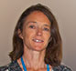
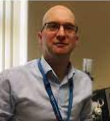
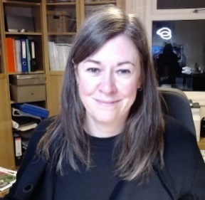
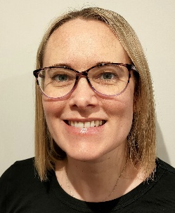
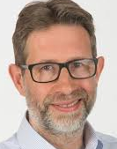
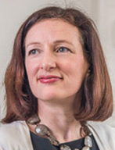
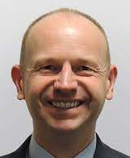
Manchester CRF Leadership 2022-27
Manchester CRF 2022-27?
Infectious Diseases, Respiratory, Mental Health
General Adult/Phase 1
Respiratory/Allergy
Manchester Royal Infirmary
NMGH
Wythenshawe
Hospital
Manchester CRF
Royal Manchester
Children’s Hospital
Salford
Royal
The Christie
Paediatrics
Dermatology, Neuroscience
Oncology
Notes:
New info here
Zoe Borrill agreed to act as Director for NMGH, mentored by Andy Utianowski
(Zoe is a Respiratory Consultant, did her PhD with Dave Singh on the MEU so has good experience of early phase work)
Richard Warren to act as Director for Salford but may not make re-bid meetings, Steve Woby is attending re-bid meetings as Richard too busy, with Hema Mistry and Vikki Goddard

Slide 6
Manchester CRF and BRC 2022-27
Manchester CRF 2022-27?
Mental Health
MSK, Hearing Health
Respiratory Medicine
General Adult/Phase 1
Infectious Diseases, Respiratory, Mental Health
Respiratory/Allergy
Manchester Royal Infirmary
NMGH
Wythenshawe
Hospital
Next Gen Therapeutics
Next Gen Diagnostics
Health Equity and Inclusivity
Manchester CRF
Royal Manchester
Children’s Hospital
Salford
Royal
The Christie
Paediatrics
Dermatology, Neuroscience
Oncology
Rare Conditions
PED, PM, DXT, Living
Dermatology, Cardiovascular
Notes:
New info here
Zoe Borrill agreed to act as Director for NMGH, mentored by Andy Utianowski
(Zoe is a Respiratory Consultant, did her PhD with Dave Singh on the MEU so has good experience of early phase work)
Richard Warren to act as Director for Salford but may not make re-bid meetings, Steve Woby is attending re-bid meetings as Richard too busy, with Hema Mistry and Vikki Goddard

Slide 7
Manchester CRF/BRC Shared Posts and Strategies
Data management team
Industry and Partnerships
PPIEP
EDI
Inclusive Research Oversight Board
Collaborate on Training

Slide 8

Manchester CRF Governance Structure
MFT Trust Board
NIHR GM Oversight Board
MCRF Governance Board
Chaired: MFT Medical Director
Membership includes: CFT Medical Director, SRFT Medical Director Vice Dean of Research FBMH, Industry Lead and patient representative
Health Innovation Manchester Board
MCRF Industry Board
Chaired: Chief Business Officer
(Catapult Medicines Discovery)
Membership includes : MCRF Director, Pharma and Biotech Representatives, BRC Industry Lead
MCRF Executive Group
Chaired: MCRF Director
Membership includes : MCRF Medical Directors, Manager and Operational Leads
Inclusive Research Oversight Board
Joint CRF/BRC group
50% of members will be lay members from our communities
Solid lines accountability for finance and governance from the MCRF Director to MFT Trust Board.
Dashed lines show links to advisory bodies

Slide 9
Active Studies by Clinical Trial Phase
Typically ~3300 recruits per year and 700 studies

Slide 10
SMART Objectives Progress
SMART Objective | Time period | Year 1
 |  | Progress | Status
Aim 1: Expand Manchester CRF Open two new CRF sites and support new investigators/specialities. By year two, we will i) integrate the new sites (Salford Royal and NMGH) ii) appoint staff to key clinical, nursing and operational roles iii) have equipped the new facilities, iv) work with local investigators to open first EM studies sites. | Short | Manchester CRF at North Manchester General Hospital • 3 studies in set-up pipeline and a new EM investigator. • 1WTE B6 Research Nurse in post. • Cross-cover Wythenshawe site. • Working with Trust Estates and Facilities to ensure appropriate space. Manchester CRF at Salford Royal Hospital • Clear working relationships and governance structures established. • Clinical and operational lead, and delivery roles in place. • Facilities enhanced to accommodate expanding portfolio • 8 trials in first 6 months | On track
Aim 2: Develop workforce skills and capabilities Standard induction across all sites and competency based training for our staff. By year one, develop and deliver standardised induction training for staff at the two new sites introduce quality and safety processes to ensure consistency of working By end of year two, all clinical/nursing/administration/operational staff agree an individual personal development and training plan. | Short | Manchester CRF Objectives incorporated into annual CRF staff appraisals. UKCRF Network Induction Booklet used for new starters and sites. With Manchester BRC develop shared education and EDI roles, Develop a staff training matrix in line with BRC/CRF EDI and BRC Capacity Building strategies. Inaugural meeting of the NWCRF Alliance with initial plans for staff moving between sites for training and EM experience agreed. | On track
Aim 3: Involve patients and the public Analyse the characteristics and diversity of our current trial participants Co-create (with patients, Manchester CRF staff, research participants and specific communities under-represented in experimental medicine research) PPIE and EDI strategies. | Short | Co-developed with Manchester BRC Equality, Diversity and Inclusion (EDI) and Patient, Public, Involvement, Engagement and Participation (PPIEP) strategies. Approved by the NIHR, and our EDI strategy was highlighted as a good example of co-production, extensive stakeholder engagement, and clear commitment from leadership at the recent UKCRF Network conference. | Complete

Slide 11


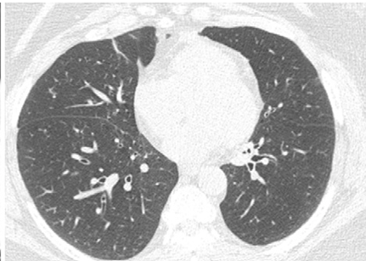
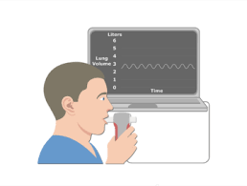
Working with Industry
Lung Health Check
Health In-equalities
NHS Long Term Plan for 1.5M people to have been invited for LHC by 2024/5
Efficient trial delivery
Low dose CT scan
Spirometry
30-35% COPD
prevalence
Notes:
Globally, 30-35% prevalence of COPD in lung cancer screening^{1,2}
Undiagnosed COPD prevalence up to 20%² in published cohort in London
50% of those are symptomatic and undertreated
Future vision to identify and treat undiagnosed COPD earlier

Slide 12

Working with Industry
Lung Health Check
EARLY PHASE COPD TRIALS NORTH MANCHESTER
Health In-equalities
Efficient trial delivery
30-35% COPD
prevalence
Notes:
Globally, 30-35% prevalence of COPD in lung cancer screening^{1,2}
Undiagnosed COPD prevalence up to 20%² in published cohort in London
50% of those are symptomatic and undertreated
Future vision to identify and treat undiagnosed COPD earlier

Slide 13
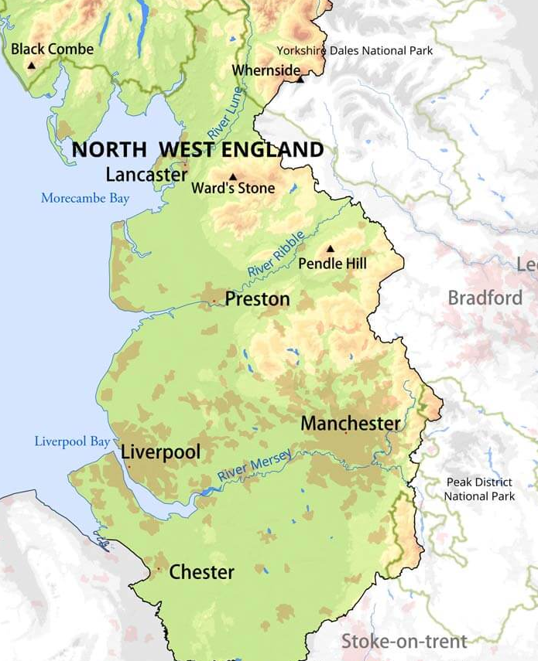
NWCRF Alliance (Alder Hey, Liverpool, Lancashire, Manchester)
Focus on phase 1 clinical trials
Scope
Sponsorship
Co-ordinated Delivery
Training
EDI
Notes:
I’d spend some time on this.
GL will ask you about Blackpool and I would say that we have reach via Preston; example Liverpool gave about supporting phase 1 at Halton.

Slide 14
UKCRF Network
Hosted in Manchester
Collaborative re-bid increased funding £2.4M
Leadership Team: Lancashire, Southampton, Cambridge and Manchester
Highly collaborative approach to developing and optimising CRF work
https://www.ukcrfnetwork.co.uk/

